Slide 1
LightGBM Regression
Light Gradient Boosting Machine

Slide 2
What is LightGBM?
LightGBM is a fast boosting framework
Developed by Microsoft
Designed for large datasets
Uses tree-based learning

Slide 3
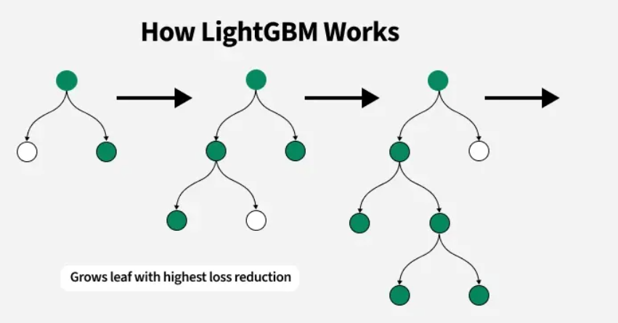
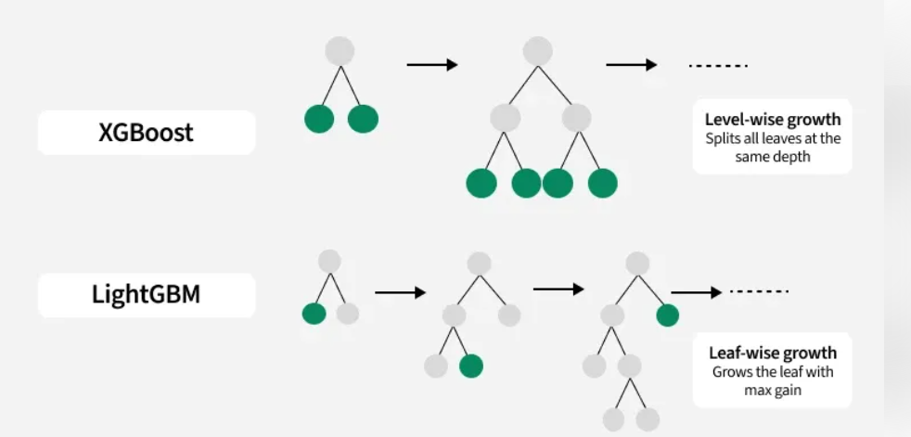
LightGBM Diagram

Slide 4
LightGBM Working
Grows trees leaf-wise, not level-wise
Chooses leaf with maximum loss reduction
Faster training compared to XGBoost
Can achieve better accuracy with fewer trees

Slide 5
Advantages & Limitations
Advantages
Very fast training
Lower memory usage
High accuracy
Limitations
Can overfit small datasets
Needs careful parameter tuning

